Slide 1
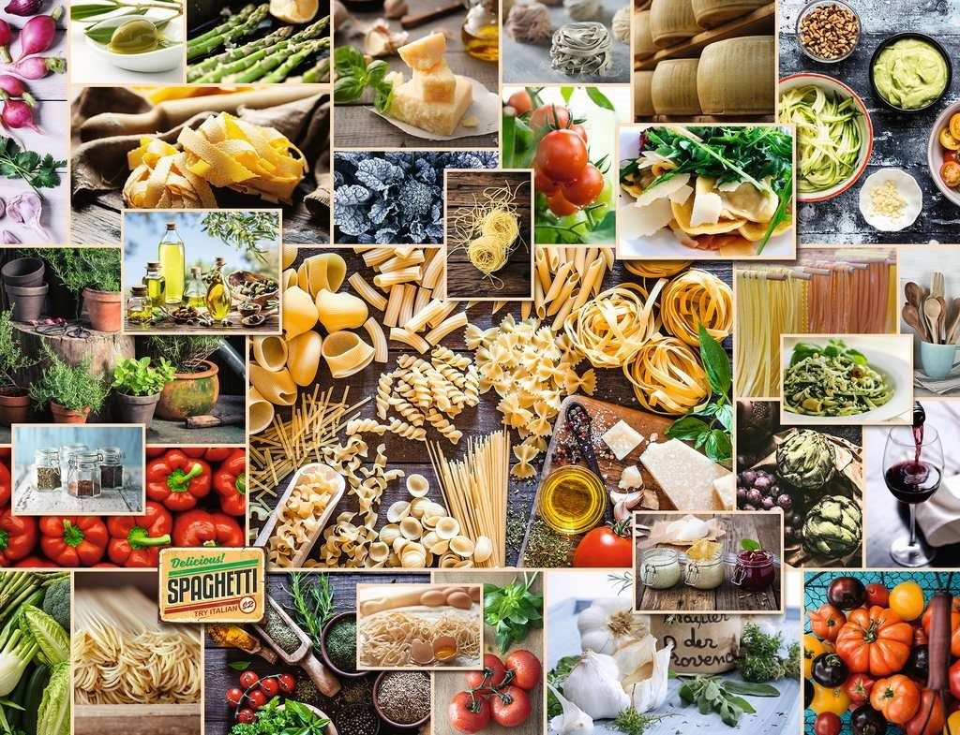

Slide 2
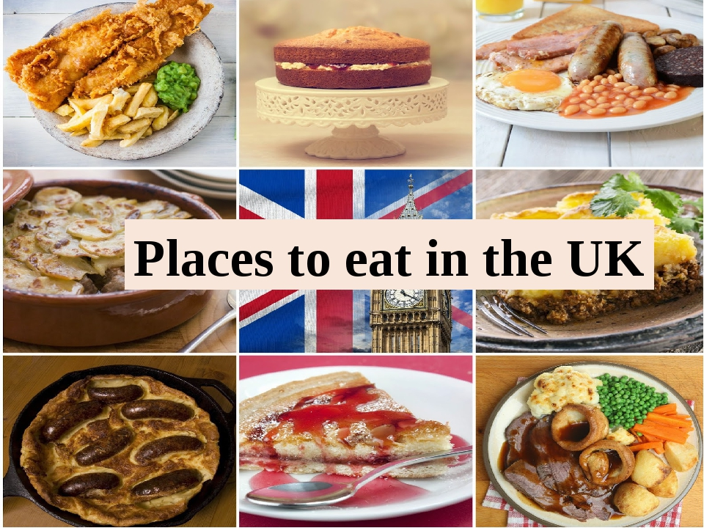

Slide 3
LET’S HAVE A REST! Look left, right Look up, look down Look around. Look at your nose Look at that rose Close your eyes Open, wink and smile.

Slide 4
1. Both the British & tourists enjoy eating there. 2. Business people have dinners there. 3. They are busy mostly at lunchtime. 4. You can eat food from many different countries there. 5. You can find them all around Britain.

Slide 5
Find the names of…
Drinks | meat | vegetables

Slide 6
Find the names of…
Drinks | meat | vegetables
soft drinks | fresh meat | fried potatoes
juice | fish | pea
coffee

Slide 7
And what place would you choose to eat out at when in the UK? I would choose _______

Slide 8
Today at the lesson I learned ….
Home task
SB p. 91 ex 5

Slide 9
You are great!

